Slide 1
Chapter 8 User Interface Design

Slide 2
Lesson Objectives
To describe the design principles of good user interface
To discuss the guidelines of designing color in an user interface
To assess the design of an user interface

Slide 3
The user interface
User interfaces should be designed to match the skills, experience and expectations of its anticipated users.
System users often judge a system by its interface rather than its functionality.
A poorly designed interface can cause a user to make errors.
Poor user interface design is the reason why so many software systems are never used.

Slide 4
Human factors in interface design
Limited short-term memory
People can instantaneously remember about 7 items of information. If you present more than this, they are more liable to make mistakes.
People make mistakes
When people make mistakes and systems go wrong, inappropriate alarms and messages can increase stress and hence the likelihood of more mistakes.
People are different
People have a wide range of physical capabilities. Designers should not just design for their own capabilities.
People have different interaction preferences
Some like pictures, some like text.

Slide 5
UI Design Process
Analysed &
understand user
activities
Produce paper-
based design
prototype
Evaluate design
with end-users
Produce
dynamic design
prototype
Evaluate design
with end-users
Design
prototype
Implement
final user
interface
Executable
prototype

Slide 6
Common Design Issues
System response time
User help facilities
Error information handling
Command labeling

Slide 7
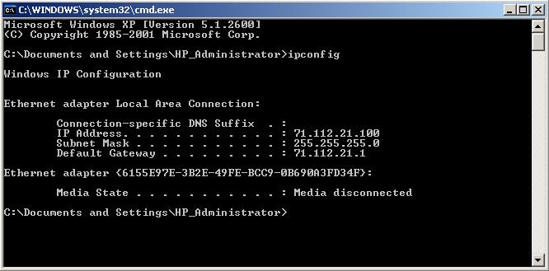
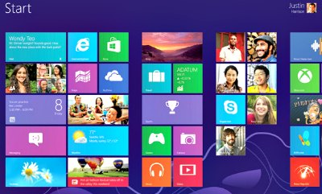
Two Modes of Designs
Basically, two modes of designs: -
text-based mode
GUI-based mode

Slide 8
Characteristics of GUI
Windows
Icons
Menus
Pointing
Graphics

Slide 9
Advantages of GUIs
Easy to learn & use
Multiple screens
Fast, full screen interaction

Slide 10
Advantages of GUIs
they are relatively easy to learn and use
the user has multiple screens (windows) for system interaction
fast, full-screen interaction is possible with immediate access to anywhere on the screen.

Slide 11


3 Golden Rules for a Good UI Design
1. Place the user in control – People do not like to be controlled by the machine and they like to know the status of the operation/ system.

Slide 12

3 Golden Rules for a Good UI Design
2. Reduce the user’s memory load – people have limited short-term memory & they make mistakes when they handle too much info.

Slide 13
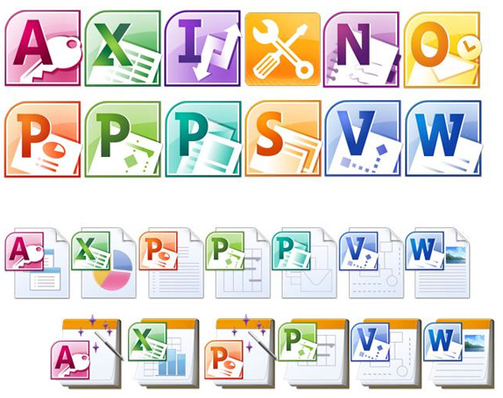
3 Golden Rules for a Good UI Design
3. Make the interface consistent – easy to learn and the knowledge learnt in one command or application is applicable in other parts of the system.

Slide 14

UI Design Principle
Needs
Experience
Capabilities

Slide 15
UI Design Principle
* Terms & concepts
* Library system
1. User Familiarity

Slide 16
UI Design Principle
* Activate operation in the same way
2. Consistency

Slide 17
UI Design Principle
* E.g. shut down immediately
3. Minimal Surprises

Slide 18
UI Design Principle
* E.g. undo
4. Recoverability

Slide 19
UI Design Principle
* Help
* Feedback on errors
5. User Guidance

Slide 20
UI Design Principle
* Experience user vs. beginner
* E.g. step-by-step installation
6. User Diversity

Slide 21
UI Design Principles
User interface design must take into account the needs, experience and capabilities of the system user.
User familiarity – should use the terms and concepts which are drawn from the experience of the users. E.g. Library system – operations: book in, book out, renew book etc.
Consistency – wherever possible, operations should be activated in the same way
Minimal surprise – users should never surprised by the behaviour of a system

Slide 22
UI Design Principles
Recoverability – should allow users to recover from errors, e.g. Undo function
User guidance – provide help feature and meaningful feedback when errors occur
User diversity – should provide appropriate interaction facilities for different types of system user. E.g. Experience user: very detailed step-by-step way to perform a function.

Slide 23

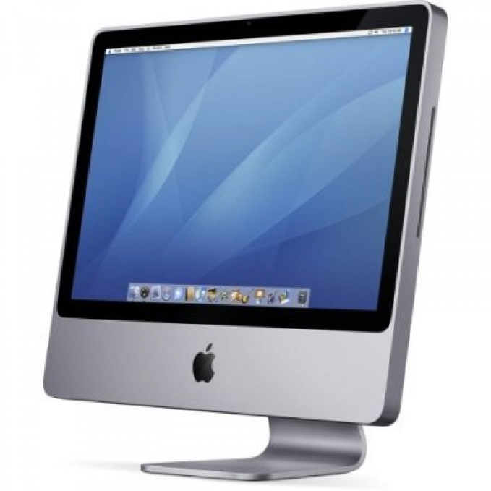


Key Issues in Interface Design
Present info
Provide info

Slide 24
Key Issues in Interface Design
The designer of a user interface to a computer is faced with two key issues:-
How can information from the user be provided to the computer system ?
How can information from the computer system be presented to the user?

Slide 25
Key Issues in Interface Design
Provide info

Slide 26


Key Issues in Interface Design
1. Direct Manipulation
E.g. resize graphic

Slide 27
Key Issues in Interface Design
2. Menu Selection/Menu Systems

Slide 28
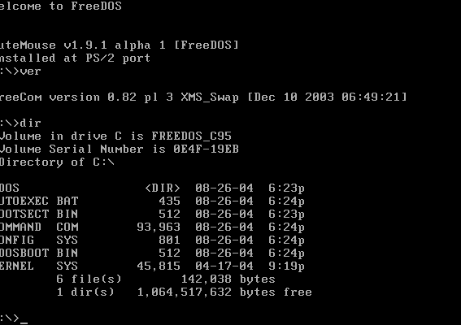
Key Issues in Interface Design
4. Command Line/Command Language

Slide 29
Key Issues in Interface Design
5. Natural Language
e.g. “delete the file named xxxx”

Slide 30
Key Issues in Interface Design
Present info

Slide 31
Key Issues in Interface Design
When presenting information to the users, the following factors must be taken into consideration:
Data Visualization
Color

Slide 32
Key Issues in Interface Design
Example : Data Visualization (Textual vs. Graphical presentation)
Jan Feb Mar Apr May June
2842 2851 3164 2500 1273 2835
4000
3000
2000
1000
Jan
Feb
Mar
Apr
May
June

Slide 33
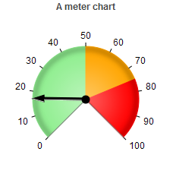

Key Issues in Interface Design
Example : Data Visualization (Present dynamically varying numeric information)
Sales

Slide 34
Key Issues in Interface Design
Example : Data Visualization (Graphical info display showing relative values)
Pressure
Temperature
0
100
200
300
400
0
25
50
75
100

Slide 35
Exercise
Q: Suggest a scenario to use Textual presentation and another scenario to use Graphical presentation.
Answer:
Textual presentation: Customer details, Order details, Account balance details, and etc.

Slide 36
Exercise
Q: Suggest a scenario to use Textual presentation and another scenario to use Graphical presentation.
Answer:
Graphical presentation:
Weather information, gathered from a number of sources, is shown as a weather map with isobars, weather fronts and so on
The state of a telephone network is displayed graphically in a network management center

Slide 37


Slide 38


The Use of Colors – Errors in Using Colors
Color is used to communicate meaning
Color blind?
Different perceptions?

Slide 39
The Use of Colors – Errors in Using Colors
Too many colors or colors too bright
Not comfortable
Confusion

Slide 40
The Use of Colors – Errors in Using Colors
Common errors made by designers when incorporating color in a user interface are: -
Color is used to communicate meaning
Color-blind may misinterpret the color
Human color perceptions are different
Too many colors or the colors are too bright in the display
Some colors cannot viewed comfortably for long
Cause confusion if colors are used inconsistently

Slide 41

Guidelines when Using Color
Number of colors
Window < 5
Interface < 7

Slide 42
Guidelines when Using Color
Color change 🡪 change of status
!
!

Slide 43
Guidelines when Using Color
Limit the number of colors used
🡪 < 5 colors in a window; < 7 colors in an interface
Use color change to show a change in system status
Change of color means that a significant event has occurred.
E.g. change of color
!
!

Slide 44
Guidelines when Using Color
Consistent
Danger 🡪 RED

Slide 45
Guidelines when Using Color
Use color coding to support the task which users are trying to perform
🡪 similar tasks – same color
🡪 abnormal tasks – different color
Use color coding in a thoughtful and consistent way
E.g. If using red for error message, all other parts should do the same.
Be careful about color pairings
🡪 Some color combinations may cause eyestrain & hard to read. E.g. Red on a blue display.

Slide 46
Guidelines when Using Color
Color pairing
Welcome to TARUC
Welcome to TARUC
Welcome to TARUC

Slide 47

Design Factors in Message Wording
Context
Experience
Skill level
Style
Culture

Slide 48
Design Factors in Message Wording
Error #27 Invalid Patient ID
Bad File Name
Illegal Operations

Slide 49
Design Factors in Message Wording
Patient J. Bates is not known to the system
Click on Patients for a list of known patients
Click on Retry to re-input a patient name
Click on Help for more information
Patients
Retry
Help

Slide 50
Support Documentation for Users
A functional description
– description of services (system evaluators)
An introductory manual
– Getting started (beginner)
A system reference manual
– facility description (experienced users)

Slide 51
Support Documentation for Users
A system installation manual
– how to install system (system administrator)
A system administrator's manual
– operation & maintenance (system administrator)

Slide 52
Exercise
Comment on the below user interface and suggest some ways to improve it (if any).

Slide 53
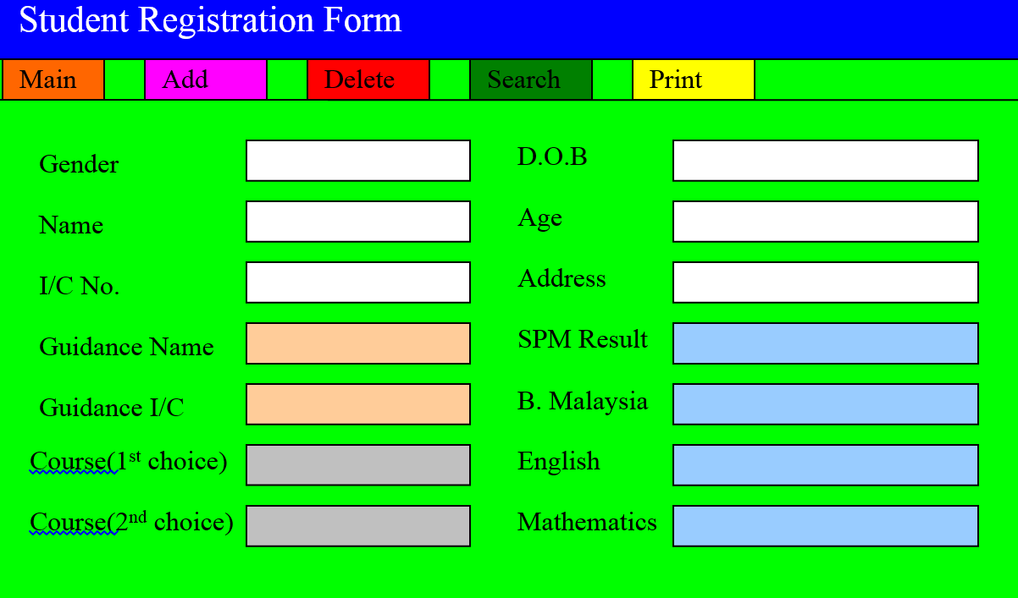

Slide 54
User interface design principles
summary

